Slide 1
Tesla &
Sunlight Financial Offering for Channel Partners
STRICTLY CONFIDENTIAL – NOT FOR DISTRIBUTION

Slide 2

Partnership Launch

Slide 3
Solar Roof Product Structure
Fixed interest rate
Instant Approval of $10K - $100K
Traditional loan amortization
Optional re-amortization at month 18
No percentage cap on amount of the project that can be “non-solar”
If Battery – no PPW cap
If no Battery - $20/watt cap
No loan transfers allowed
Keep tax credit:
payment stays the same
Installation
Payment 1
(60 days
after install)
Payment 17
Payment 18
Rest of
Loan Term
Use tax credit to pay back X% of the loan:
Payment lowers at month 18
X%

Slide 4
Loan Products and Pricing
SolarRoof, SolarRoof + Powerwall Loans
Term | APR | Dealer Fee (80/20) | Dealer Fee (100/0)
10 year | 2.99% | 12.50% | 13.00%
10 year | 3.99% | 9.00% | 9.50%
10 year | 4.99% | 7.00% | 7.50%
10 year | 5.99% | 4.00% | 4.50%
20 year | 4.99% | 11.50% | 12.00%
20 year | 5.99% | 7.00% | 7.50%
20 year | 6.99% | 3.00% | 3.50%
*Increase dealer fee by 0.50% for FL, increase dealer fee by 1.00% for PA.

Slide 5
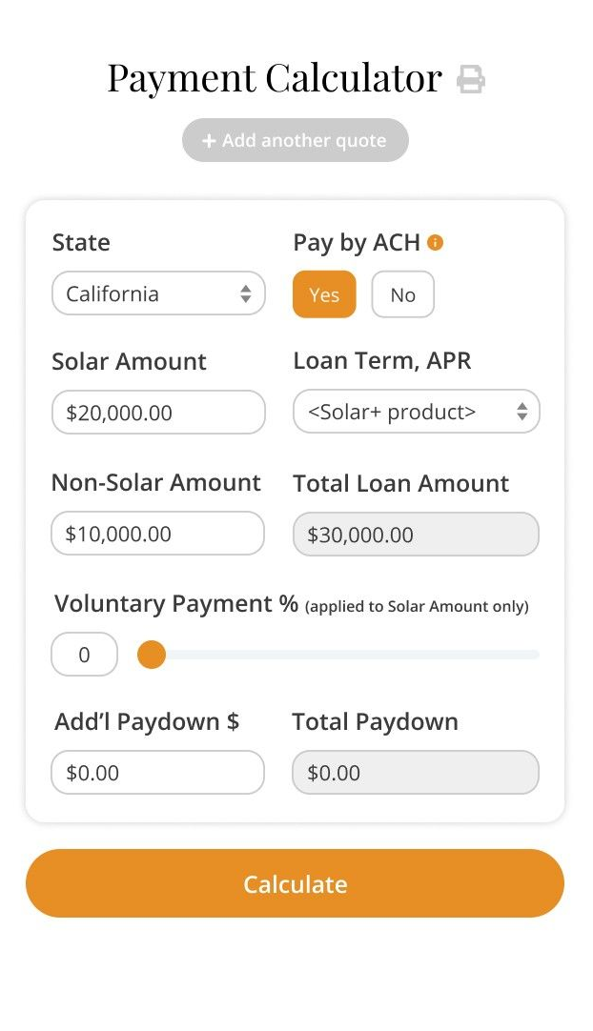
How to Quote Using the Payment Calculator
The payment calculator allows you to show hypothetical voluntary payments and how they affect the 18-month reamortization.
Initial monthly payment on the loan will assume the customer makes no voluntary payment in the first 18 months of the loan

Slide 6
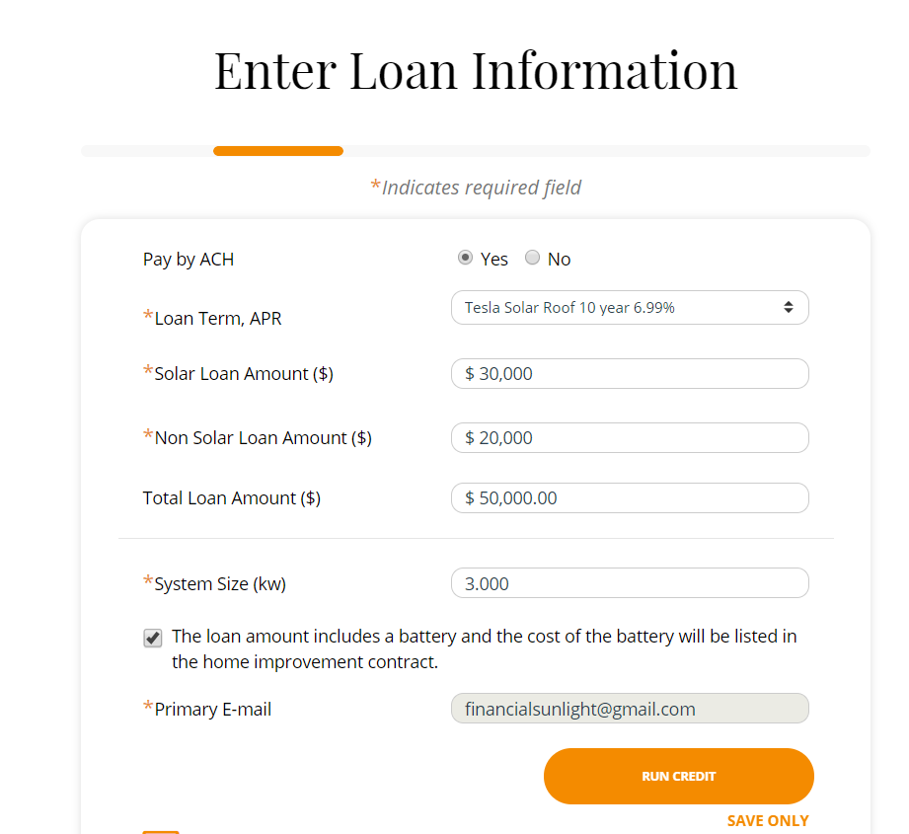
Running a Credit Application
Enter the “Non-Solar Loan Amount” prior to the credit application
This is an amount shown on the loan agreement to strengthen our UCC-1 filing since the Solar Roof is a new asset

Slide 7
Running a Credit Application

